Slide 1
Sales & Operations Planning
Matching Consensus Demand Planning To Manufacturing Capabilities Program Overview, Implementation & Training Module

Slide 2

Other Modules In This Series:
5S
Standard Work
Total Productive Maintenance (TPM)
Administrative Lean
Cell Design/ Production Preparation Process (3P)
Kaizen
Kanban
Problem Solving
Poka Yoke Quality Systems
Transaction Process Improvement (TPI)
Cause & Effect Diagram with the Additions of Cards (CEDAC)
Single Minute Exchange of Dies (SMED)
Value Stream Mapping (VSMi®)
Visual Management
Managing Daily Process Excellence
For More Information Please Contact:
Mark DeLuzio, President and CEO
+1.860.234.0915
mark.deluzio@leanhorizons.com
Strategically Creating Value Through the Elimination of Waste

Slide 3
This document contains confidential
and proprietary information owned
by Lean Horizons Consulting, LLC.
Any disclosure, use, copying or
distribution of this information without the express written consent of Lean Horizons Consulting is strictly prohibited.

Slide 4
Ground Rules for Event
Safety first (use personal protective equipment)
Active participation by all
Start and end on time
All electronic gadgets (phones, pagers, etc) turned to “off” or “silent”
Computers to be used only when instructed
Keep an open mind to change
Don’t let “perfect” get in the way of “better”
Notes:
DO: Ask the group if they have any ground rules to add (capture them on chart paper).
Ask the group if they agree to these ground rules.
DO: Perform Group Introductions

Slide 5
S&OP Defined:
Integrated, “One Plan” Driving Entire Enterprise
Demand Planning
How much does the
Customer Need?
Supply Planning
How will we produce, fulfill
And deliver the product?
“The Definition”
S&OP is an integrated process that consolidates all areas of the business into a single, Integrated set of operations plans
“One Plan” Driving The Enterprise
Buy
Move
Make
Sell
Sales & Operations Planning
“The Complete Balance of Customer Needs
With Our Supply Capabilities”
A disciplined, methodical process designed to synchronize supply & demand in order to provide superior customer service.

Slide 6
SIOP Defined:
Integrated, “One Plan” Driving Entire Enterprise
Demand Planning
How much does the
Customer Need?
Supply Planning
How will we produce, fulfill
And deliver the product?
Is a MONTHLY process ensuring that all aspects of the company are aligned , focused and engaged in meeting business priorities
Manages continuous change by matching the required internal resources to the challenges faced “this month” in the marketplace
Owned by a prominent individual; fosters a cross-functional environment to maximize the value each function brings to the supply & demand matching process
Addresses critical resource requirements across the enterprise in order to match current demand or make alternative plans if internal resources are insufficient
Provides senior management with business control – simple, disciplined process to govern and provide superior customer service
Sales & Operations Planning
“The Complete Balance of Customer Needs
With Our Supply Capabilities”
Simple, Disciplined, Continuous
S&OP must become a standard monthly process through which the resources of the enterprise are evaluated against changes in the marketplace.

Slide 7
Sales & Operations Planning:
Synchronizing Supply & Demand
Demand Planning:
“Understanding Customer Pull”
Supply Planning:
“Translating Pull to Product”
Develop and deploy cross-functional team that develops “one plan” to synchronize supply chain against customer pull
Weekly, monthly & quarterly S&OP planning continually matches supply, demand and Acuity resources
Provides Structure: Stabilizes environment, enables total information dissemination and builds universal production plan
Drives Improvement: Permits effective product segmentation, integrates metrics with scheduling and automates data collection
Enhances Performance: Exception-driven, links S&OP plan to profitability/customer satisfaction and improves resource allocation
Complete alignment of supply, demand, lifecycle management and business strategy
Sales & Operations Planning:
“Customer Pull Balanced with Supply Capabilities”
Pull of the Customer
Sales Plan
Financial Plan
Sales/ Marketing
Customer Service
Finance
Logistics
Manufacturing
Product Roadmap
Production Plan
Synchronized “One Plan” Delivery
New Metrics, New Team, Deep Analytics, Common Data
Improvement Gateway: “One Plan” Capability Drives Cost Reductions

Slide 8
Supply-Demand Matching:
Optimizing All Drivers, Not One Over The Other
Service
Service Levels
What are the national service levels? By Customer?
What are the current attainment levels?
How often evaluated?
Corporate objectives achieved by service levels?
Variability
Time
Inventory
Current raw materials inventories
Current finished goods inventories
In-field deployment of inventory (distribution centers)
Inventory
Cost
$$$ Economics
Financial Cost
Manufacturing costs & outsource production costs
Raw materials procurement costs
Transportation and materials handling costs
S&OP Links The Fundamental Business Drivers;
Optimizes All Without Sacrificing One Over The Other
Designed to maintain (and promote) balance across key business to achieve key corporate goals and objectives.

Slide 9
De-Coupling Demand And Supply: Understanding the S&OP Hierarchy
S&OP Analysis Hierarchy
Typically, the combined analysis of supply and demand rapidly leads to compromises and illogical choices
Demand (external view) and supply (internal view) should be assessed separately in order to confirm true capabilities and true wants
Once the separate analysis are complete, supply and demand can be assembled to build the optimal solution for the enterprise
Organization frequently confuse “volume” and “mix;” most jump right to questions of mix
As is the case with supply and demand, volume and mix are separate analysis within S&OP and required individualized attention
Demand Forces
Supply Forces
Production Volumes
Production Mix
S&OP Goal: Distinct Analysis; Optimal Solutions
The primary goal of S&OP is to “de-couple” supply from demand in order to evaluate each separately (and accurately) and then bring them together in the real world to align resources to customer demand.

Slide 10
S&OP Timing Schematic:
Clear, Predictable Path For Roadmap Creation
Day 10
Day 15
Day 22
Day 28
Consensus
Demand
Forecast
Consensus
Supply
Planning
Executive
S&OP
Meeting
Master
Production
Scheduling
Goal
Create the most accurate demand plan based on field inputs, historical analysis and consensus agreement
Critically evaluate available production resources to determine the optimal mix to meet forecasted demand
Review recommended plan, make any necessary changes, resolve conflicts and approve the path forward
To prepare end item production schedules that meet the monthly production plan by product family
Objectives
Gather latest market activity from field
Update system generated forecasts
Review and apply judgments
Review predicted results
Adjust for strategy
Reach forecast consensus
Review historical performance
Update production plans
Review critical resource constraints
Make resource decisions
Assess decision impacts and prepare for executive meeting
Review recent performance
Settle undecided issues
Review impact statement
Approve current months S&OP roadmap
Move to production
Load most current forecast
Execute MPS program
Address exception messages
Identify / Resolve / Communicate schedule changes
Firm up MPS at time fence

Slide 11
S&OP Summary:
Integrated, Disciplined Process To Meet Customer Needs
Management Sign-Off
Review performance metrics
Assist where no consensus was reached
Understand tradeoffs
Sign off on agreed plan
Physical Assets
Market Forecasts
Supply Analysis
Demand Analysis
-- Integrated Plan --
Assess demand plan
Evaluate constraints
Agreement on available capacity
Consensus agreement on constraints & solutions
Consensus next-month demand plan
Agreement on Demand assumptions
Review forecast changes and rationale
Supply Matched To Demand
Constraints Known & Understood
Link To Business Objectives
New Products Analysis
Supply Constraints
Review status of current crop of projects
Understand which products require capacity
Build in raw materials and capacity needs
Customer Forecasts

Slide 12
S&OP Flexibility Model:
Utilization Across Different Operating Platforms
Make-To-Stock
Actual Order
Product made to a specific inventory level
Good shipped from inventory as physical orders received
Most Basic S&OP platform
Demand
Forecast
Build
Products
Add Products
To Inventory
Ship
Products
Make-To-Order
Product made only after physical order received
Essentially “no inventory” model
Inventory replaced with backlog on S&OP documents
Demand
Forecast
Actual Order
Build
Products
Ship
Products
Configure-To-Order
Most complex S&OP set-up
Postponement delays high-cost value adds until orders received
“Inventory” replaced with “module inventory”
Actual Orders
Product A
Demand
Forecast
Generic
Production
Generic
Inventory
Product B
Ship
Products
Product C
Differentiate

Slide 13
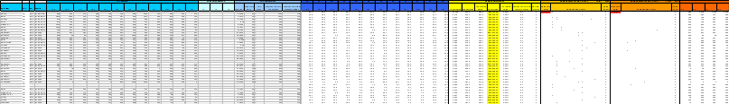

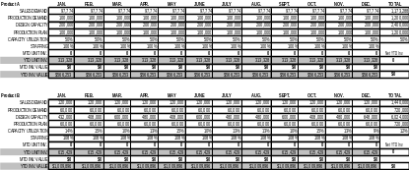


S&OP Program Deliverables:
Turnkey S&OP Process For Roll-Out
Demand Plan & Forecast
S&OP Playbook
Pilot
Families
Inv
Lyd Ytd
Daily
Cls
Lyd Qty
Ytd Qty
Qty
Part
PO Bal
Vendor
ABC
Std Cost
Ave
On
Days
50
3,787
824
4,611
C-04
3,743
94254
C
$1.48
Usage
Hand
Inventory
A-03
M-03
J-03
J-03
50
644
0
644
C-04-0CP
250
94254
C
$1.32
6
206
34.33
50
14,330
5,178
19,508
C-05
6,077
94254
C
$1.23
0
200
0
50
3,406
690
4,096
C-05-0CP
967
94254
C
$0.96
33
330
10
Family
Phase Plan
50
709
487
1,196
CL-04
94254
C
$1.39
4
354
88.5
100
50
3,688
1,305
4,993
CL-05
7,100
94254
C
$1.30
5
50
3,458
1,678
5,136
FC2-03
4,552
94254
C
$0.80
18
50
1,362
52
1,414
FC2-03-0CP
480
94254
C
$0.59
10
1,360
136
50
5,657
1,395
7,052
FC2-04
94254
C
$1.10
1
48
48
50
3,548
850
4,398
FC2-04-0CP
2,911
94254
C
$0.68
10
830
83
50
19,760
5,057
24,817
FC2-05
7,432
94254
C
$1.18
3
600
200
50
9,508
1,006
10,514
FC2-05-0CP
4,078
94254
C
$0.72
45
7,807
173.49
138
675
50
7,872
1,530
9,402
FC2-06
4,261
94254
C
$1.10
10
841
84.1
50
873
515
11
1,331
121
S&OP
Spreadsheet
S&OP Executive
Meeting Structure
S&OP Plan Final
Supplier Demand
Plan
Defined
Roles
Production Capabilities Plan
S&OP supply-demand matching spreadsheet
Rough-cut capacity planning spreadsheet
Forecast generation and review process
Documented S&OP policies and procedures
Executive review and go-forward decision criteria
Complete-cycle S&OP process on pilot family
Detailed roll-out schedule for remaining families
Boot camp training delivery to team members

Slide 14
Monthly Cycle Schematic:
Complete Cycle To Monthly S&OP Success
Last-Month Results
Day 0
Day 30
Data Assembly
Day 5
Demand Planning
Day 10
Supply Planning
Day 15
Pre-S&OP Meeting
Day 20
Exec S&OP Meeting
Day 22
Review Past-Month Results
& Forecast Accuracy
Build Consensus Forecast
For Next-Month Production
Available Capacity Analysis
Mismatch Identification
Supply-Demand
Confirmation
Finalize Next-Month
S&OP Roadmap
All inputs for forecast generation and demand analysis
Consensus forecast based on current demand & error rate analysis
Confirmed capacity constraints and capacity error code identification
Supply-Demand match with contingency plan where required
Business case creation outlining S&OP plan and key trade-offs

Slide 15
Demand Planning 1:
What Did The Last-Month Cycle Tell Us?
Last-Month Results
Day 0
Day 30
Data Assembly
Day 3
Demand Planning
Day 10
Supply Planning
Day 15
Pre-S&OP Meeting
Day 20
Exec S&OP Meeting
Day 22
New
Statistical
Forecast
Required Discipline:
Evaluating Error Rates
Existing customer mix
Potential new customers
New products or reengineered products
Price changes
Marketplace conditions
Seasonal promotions
Industry factors
Last-Month
Forecast
Last-Month
Actuals
Next-Month
Adjustments
New
Product
Inputs
Consensus
Management
Forecast(s)
Last-Month
Actuals
Next-Month
Adjustments
Error Rate
Analysis
“First Pass
S&OP
Spreadsheet”
Actual Production Output
Team members must critically evaluate “how we did” in order to understand error rates and their impact on the next planning cycle.

Slide 16
Demand Planning 2:
Statistical Forecasts To Management Forecasts
Last-Month Results
Day 0
Day 30
Data Assembly
Day 3
Demand Planning
Day 10
Supply Planning
Day 15
Pre-S&OP Meeting
Day 20
Exec S&OP Meeting
Day 22
New
Statistical
Forecast
Critical Factors
Required Discipline:
Evaluating Error Rates
Job is to transform a “statistical” forecast into a “management” forecast through key input analysis and error rate evaluation
All assumptions should be clearly documented for inclusion in the business case
New product development must be included; what new or re-designed products are being released?
Once units are forecasted, sales and marketing must then translate them into dollar levels
Senior sales management must be in the loop here; they effectively “sign off” on the management forecast
Last-Month
Forecast
Last-Month
Actuals
Next-Month
Adjustments
New
Product
Inputs
Consensus
Management
Forecast(s)
Last-Month
Actuals
Next-Month
Adjustments
Error Rate
Analysis
Actual Production Output
Forecast error analysis must become an institutional discipline for effective S&OP management
Depending on the outcome, error rate analysis may have a significant impact on the next-month S&OP cycle
Error rate analysis key to “operationalize” statistics

Slide 17
Sales & Operations Planning
    Introduction To The Sales & Operations Planning Process
S&OP Logic Flow & Application In Different Operating Environments
S&OP Monthly Development Process & Execution Review
Demand Planning: Fundamentals of Consensus Demand Development
Supply Planning: Overview of Resource Management & Allocation
S&OP Spreadsheet Development, Responsibilities & Best Practices

Slide 18
Supply Planning Introduction:
Matching Resources To Demand
With the first-pass S&OP spreadsheet complete (demand plan), supply team members are now tasked with the responsibility to evaluate available resources and build the most appropriate production plan to meet that demand.
Generate Product
Or Family Sales
Forecast(s)
Marketing Team
Members
S&OP Team
Sign-Off
Including
Procurement
& Sourcing
Requirements
SALES
Supply Chain
Team Members
Collect Market
Forecast(s) From
Various Markets
Develop Demand
Plan & Inventory
Requirements
Receive Net
Requirements
From
Supply Chain
Develop Initial
Production
Plan Based on
Net
Requirements
& Available
Capacity
Production Planning
Team Members
OPERATIONS
Initial
Supply &
Demand Plan
Production Scheduling
Team Members
Day 10
Day 15

Slide 19
Supply Planning Introduction:
Existing Resources To Meet Supply
Supply
Planning
Demand
Planning
S&OP Focus
Raw Materials
Manufacturing
Resources
Distribution &
Logistics
Forecasted Demand
Unbiased, realistic appraisal of the production horsepower that can be brought to bear to meet next-month demand
Documented understanding of theoretical capabilities, demonstrated capabilities and existing constraints (e.g. maintenance issues, etc.)
Consensus plan development of “doing what we can with what we have” leading to “maximizing ALL that we have”
One-plan Consensus-driven snapshot of next month customer requirements
Supply Meets Demand
Supply Augmented To Meet Demand
Supply Cannot Meet Demand

Slide 20
Supply Planning Commencement:
Last-Month Results, Next-Month Match
Generate Product
Or Family Sales
Forecast(s)
Demand planning team members submit first-pass “net requirements” spreadsheet to supply planning team members
Supply planning team evaluates net requirements and begins process of matching net requirements to available (or potentially available) supply resources
Production contingency planning begins including staffing scenarios, extra shifts, overtime, outsourcing, etc.
Supply team members develop the consensus supply plan and then prepare for the final supply-demand match
Demand Team
Members
S&OP Team
Sign-Off
Including
Procurement
& Sourcing
Requirements
SALES
Demand Team
Members
Collect Market
Forecast(s) From
Various Markets
Develop Demand
Plan & Inventory
Requirements
Production Planning
Team Members
Receive Net
Requirements
From
Demand Team
Develop Initial
Production
Plan Based on
Net
Requirements
& Available
Capacity
OPERATIONS
Production Scheduling
Team Members
Initial
Supply &
Demand Plan
Day 10
Day 15
Last-Month Actual Results
Available Production Capacity
Possible Shortage Solutions
Worst-Case Planning Scenarios
Critical
Resource
Evaluation
Performance Metrics Review
Actual
Capacity
Used
Next-Month
Maintenance
Scheduling
On-Hand
Inventory
Analysis
Rough-Cut
Capacity
Analysis
Error Code
Evaluation
Second-Pass
Spreadsheet
“Capacity Plan”
Required Inventory Position

Slide 21
Supply Planning Commencement:
Demand Against Available Resources
Last-Month
Operating
Results
Analysis & Feedback Loop: Continuous Improvement Required
“Last-Month” Incorrect
Capacity Availability Assumptions
Beginning with last-month operations results and next-month “known” capacity constraints, the supply team must begin to construct the most realistic capacity plan to be matched against demand.
Throughput
Downtime
Scrap
OSCOT
Overtime
Last-Month Results Analysis
Last-Month
Actual
Capacity
Used
Maintenance
Capacity
Lost
“Next-Month” Confirmed
Capacity Reductions & Limitations
Next-Month
Maintenance
Schedule
Planned
Output Vs.
Actual
Output
“Next Month”
Actual Available Capacity
Planned Mtc
Routine PM’s
Downtime
Timing
Capacity Loss
Last-month actuals analysis
Capacity not used or misused
Available capacity for next month
Last-Month Actual Results
Critical
Resource
Evaluation
Performance Metrics Review
Actual
Capacity
Used
Next-Month
Maintenance
Scheduling
On-Hand
Inventory
Analysis
Rough-Cut
Capacity
Analysis
Error Code
Evaluation
Second-Pass
Spreadsheet
“Capacity Plan”
Required Inventory Position
Notes:
OSCOT = Orders Shipped Complete On Time

Slide 22
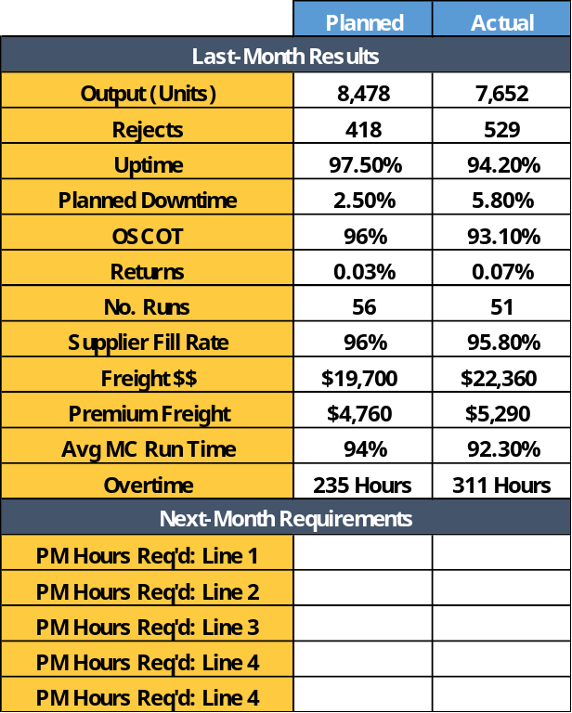
Supply Planning & Metrics Review: Consolidated Scorecard Necessary
Sample Scorecard
Last-Month Review
Demand planning team members will have to be in a position to quickly evaluate last-month results
Feedback cycle requires a critical assessment of last-month results to determine if supply assumptions were accurate (and if not, by how much)
Basic metrics should focus on uptime, throughput, downtime, OSCOT, scrap, and supplier performance
Demand team members must determine if last-month performance deficiencies will be repeated next month,
As an integral component of the demand planning process, S&OP pilot members should, if it does not already exist, aggregate all basic operational metrics into a simple balanced scorecard in order to properly evaluate capacity constraints.
Maintenance Considerations
Team must have a thorough understanding of next-month maintenance requirements
What preventive maintenance procedures are required, and what maintenance is optional (if demand warrants)
Required maintenance should be considered mandatory in order to match supply to an accurate depiction of available capacity
Last-Month Actual Results
Critical
Resource
Evaluation
Performance Metrics Review
Actual
Capacity
Used
Next-Month
Maintenance
Scheduling
On-Hand
Inventory
Analysis
Rough-Cut
Capacity
Analysis
Error Code
Evaluation
Second-Pass
Spreadsheet
“Capacity Plan”
Required Inventory Position

Slide 23
Supply Planning & Metrics Review:
Building The Scorecard Feeders
Procurement &
Sourcing
Departmental
Responsibility
In order to build the most accurate and timely performance scorecard, demand team members should thoroughly process-map all “feeds” into the scorecard in order to properly assign responsibilities and development requirements.
Customer Service
Data Format
Requirements
Plant Engineering
& Maintenance
Data Submission
Timing
Production Scheduling
Manufacturing
Operations
Load Into
Scorecard
Last-Month Actuals & Assumptions Review Process
Last-Month Actual Results
Critical
Resource
Evaluation
Performance Metrics Review
Actual
Capacity
Used
Next-Month
Maintenance
Scheduling
On-Hand
Inventory
Analysis
Rough-Cut
Capacity
Analysis
Error Code
Evaluation
Second-Pass
Spreadsheet
“Capacity Plan”
Required Inventory Position

Slide 24
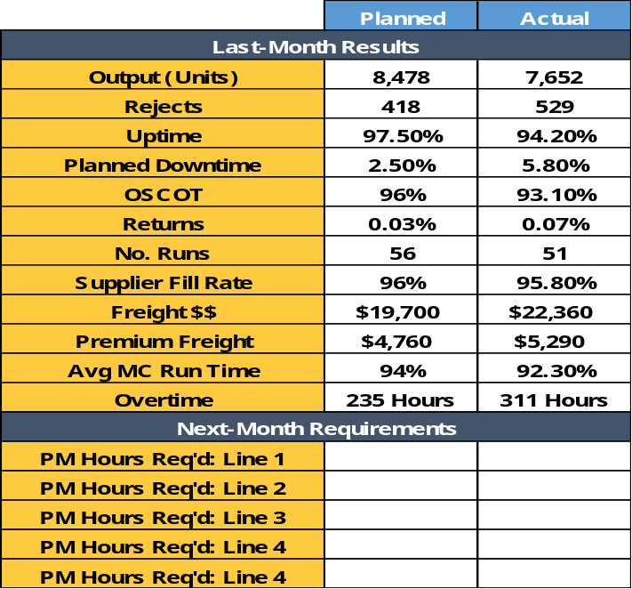
Last-Month Demand Plan Analysis:
Confirm Next-Month Impacts
Before the pilot team members can build the next-month supply plan, last-month performance actuals must be critically evaluated in order to determine if key issues exist that may reduce available supply capacity.
Was analysis accurate?
Control chart noise?
Trending identified?
Misunderstood capabilities?
Analysis Results
Unforeseen events?
Improvement over last month?
Decline over last month?
Track record of unsustainable performance levels?
Demand plan inputs
Maintenance requests
Customer order requirements
Staffing availability
Runtime averages
Production mix
Supplier capabilities
Next-Month Impacts
Long-term trend analysis
Next-month limiting factors
Key shop-floor execution problems
Training or quality issues
Decline in overall available capacity?
Last-Month Actual Results
Critical
Resource
Evaluation
Performance Metrics Review
Next-Month Planning: “Increased Accuracy”
Actual
Capacity
Used
Next-Month
Maintenance
Scheduling
On-Hand
Inventory
Analysis
Rough-Cut
Capacity
Analysis
Error Code
Evaluation
Second-Pass
Spreadsheet
“Capacity Plan”
Required Inventory Position

Slide 25
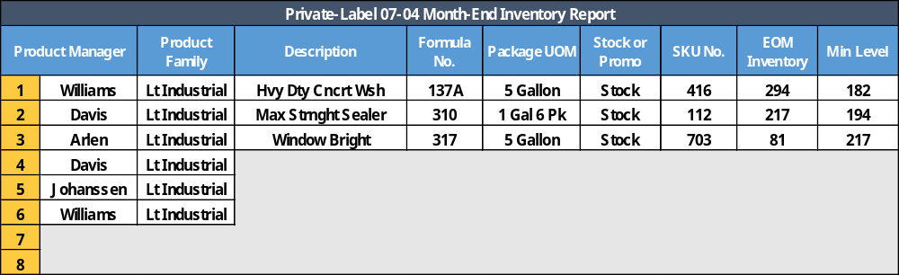

On-Hand Inventory Analysis:
Sufficient, Deficient, or Excessive?
Previous
Month
Actuals
Along with the last-month performance review analysis, supply planning team members must also critically evaluate the organization’s inventory position to determine if customer service issues are looming.
Output
Returns
Inventory On-Hand
Trending
Min-Levels
Over-Build? Under-Build? Supplier Problems?
Last-Month Actuals Analysis
Next-Month Ramifications
Was the inventory plan sound and did it meet service requirements?
What trends are identified – Growing inventory? Shrinking?
Root cause analysis – Supplier issues? Min-Max levels incorrect?
Does the production need to be increased to build up inventory levels?
Decrease build plan to draw down inventory levels?
Adjust incoming supplier shipments to fine-tune build plan?
Last-Month Actual Results
Critical
Resource
Evaluation
Performance Metrics Review
Actual
Capacity
Used
Next-Month
Maintenance
Scheduling
On-Hand
Inventory
Analysis
Rough-Cut
Capacity
Analysis
Error Code
Evaluation
Second-Pass
Spreadsheet
“Capacity Plan”
Required Inventory Position

Slide 26
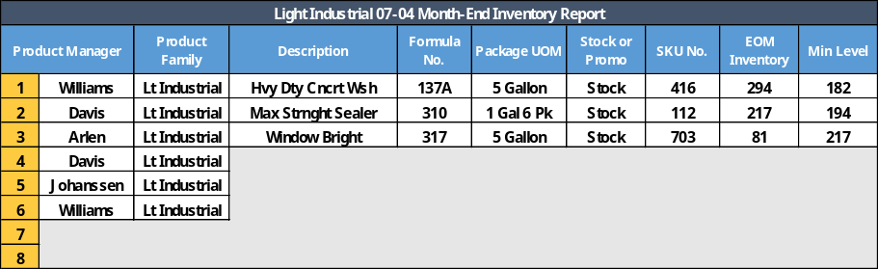
On-Hand Inventory Analysis:
Continuous Requirements Analysis
Service Requirements
Min-Max’s
Correct?
OSCOT
Max Stock out Levels
Contractual Guarantees
DC-Level Deployments
Production Lead Times
Service Levels
Accurate?
As an integral part of the on-hand inventory analysis, team members should continuously evaluate service and min-max requirements to promote continuous improvement and tighter linkages between supply and demand.
Min-Max
Adjustments
Service Level
Adjustments
Supplier
Problem ID
Supplier
Course
Corrections
Confirmed
Next-Month
Impacts
Continuous review of inventory stocks
Control chart analysis – Are we ready to increase service to the next level?
Are suppliers living up to contractual expectations?
Should suppliers be placed on a watch list?
Last-Month Actual Results
Critical
Resource
Evaluation
Performance Metrics Review
Actual
Capacity
Used
Next-Month
Maintenance
Scheduling
On-Hand
Inventory
Analysis
Rough-Cut
Capacity
Analysis
Error Code
Evaluation
Second-Pass
Spreadsheet
“Capacity Plan”
Required Inventory Position

Slide 27
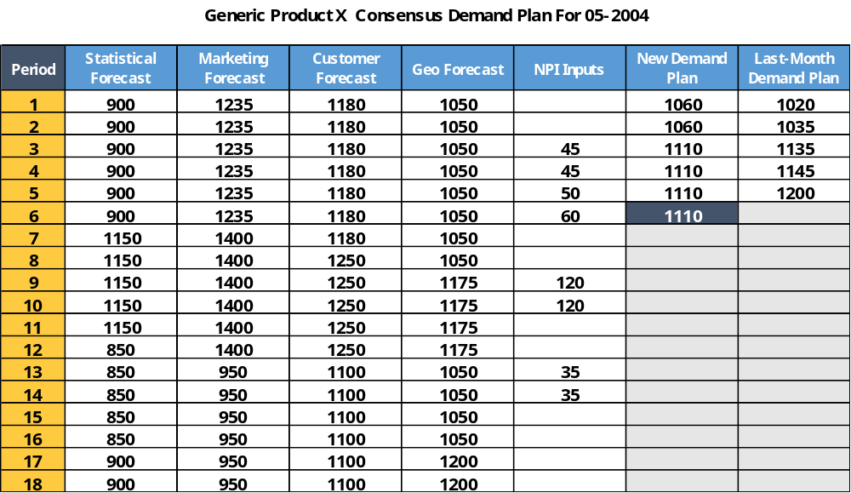
Demand Inputs:
Commencing The Supply Planning Analysis
First-Pass S&OP Spreadsheet
Demand planning team passes first-pass spreadsheet to supply team
Supply team evaluates the consensus demand figure(s) for the given product, family or multiple products
Team should conduct an initial review to confirm if there are significant changes:
  Significantly increased demand
  Substantial demand reduction
Extraordinary demand should be verified by the supply team to avoid planning to an incorrectly transmitted number
Team should also evaluate changes made based on last-month “lessons learned” on forecast accuracy
With the last-month actual results, maintenance and inventory planning analysis complete, the supply teams can then begin assessing the “first pass” S&OP spreadsheet from sales to match available capacity to consensus demand.
Rolling Period Forecasts
Updated As Required
Next-Month
Consensus Plan
Last-Month Actual Results
Critical
Resource
Evaluation
Performance Metrics Review
Actual
Capacity
Used
Next-Month
Maintenance
Scheduling
On-Hand
Inventory
Analysis
Rough-Cut
Capacity
Analysis
Error Code
Evaluation
Second-Pass
Spreadsheet
“Capacity Plan”
Required Inventory Position

Slide 28
Supply Planning Pathway:
Matching Specific Resources To Products
1
Aligned Resources Analysis
2
-- OR --
Non-Aligned Resources
Analysis
As the first step, supply team members (based on their operating environment) begin the planning process by matching the demand plan to the resource “buckets” that will be required to build the required products.
3
-- Factoring In --
Capacity Constraints
4
-- Yielding --
Confirm Net Capacity
5
-- Allowing For --
The demand plan will identify the products and number of products required
This in turn indicates to the supply team which resources will be called into play for the next-month roadmap
Match Supply & Demand
Last-Month Actual Results
Critical
Resource
Evaluation
Performance Metrics Review
Actual
Capacity
Used
Next-Month
Maintenance
Scheduling
On-Hand
Inventory
Analysis
Rough-Cut
Capacity
Analysis
Error Code
Evaluation
Second-Pass
Spreadsheet
“Capacity Plan”
Required Inventory Position

Slide 29
Demand Planning First Step:
Defining The Operating Environment
1
Aligned Production Resources
2
Unaligned Production Resources
Product
A
Product
B
Product
C
Product
D
Product
E
Product
F
With a detailed focus on production capabilities, the S&OP pilot team must first confirm the type of operating environment that exists – Aligned resources or “unaligned” resources.
Production
Resource
1
Production
Resource
2
Production
Resource
3
Production
Resource
1
Production
Resource
2
Production
Resource
3
Production
Resource
4
Production
Resource
5
Production
Resource
6
One-for-one relationship between resource and specific product (or product family)
Individual product or product family uses “all” of the dedicated production resource
Production resources are used to support multiple products or product families
One-for-one resource-product match does not exist; demand planning must isolate best method to match capacity across many resources to a specific product
Last-Month Actual Results
Critical
Resource
Evaluation
Performance Metrics Review
Actual
Capacity
Used
Next-Month
Maintenance
Scheduling
On-Hand
Inventory
Analysis
Rough-Cut
Capacity
Analysis
Error Code
Evaluation
Second-Pass
Spreadsheet
“Capacity Plan”
Required Inventory Position

Slide 30
Aligned Vs. Non-Aligned Resources:
Where Should Time Be Spent?
Aligned
Resources
Typically involves manufacturing operations where specific departments or functions are responsible for a stand-along product or product family
In most cases, the capacity check is performed right on the S&OP spreadsheet; since there is a one-for-one linkage, the operations plan is the entire workload of the resource in question
Usually simple to understand quickly what rates can be hit, when they can be hit, under what circumstances breakpoints are reached, etc.
“Move on in the process:” Aligned resources represent a simple working model
No clear linkage between the resources in question and the product or product family
Non-aligned resources represent distinct and stand-alone assets; once “demand” is established, non-aligned resources must be matched to their highest-valued use
Typically, the “translation” of supply to demand in this case is knows as rough-cut capacity planning
Proper classification of your manufacturing environment is critical early on the S&OP pilot stage; S&OP processes in the non-aligned production facility require additional steps to ensure proper evaluation (and use) of available capacity.
Non-Aligned
Resources
Non-Aligned Resources? “Rough Cut Capacity Planning” Is The Key
Last-Month Actual Results
Critical
Resource
Evaluation
Performance Metrics Review
Actual
Capacity
Used
Next-Month
Maintenance
Scheduling
On-Hand
Inventory
Analysis
Rough-Cut
Capacity
Analysis
Error Code
Evaluation
Second-Pass
Spreadsheet
“Capacity Plan”
Required Inventory Position

Slide 31
Aligned Operating Environments:
Specific Product, Specific Platform
Aligned Resource Example
3
4
Cell operation example demonstrates simplicity of the model; specific product assigned to specific operating platform
Each cell location dedicated to production of a single product or family
Average throughput and best-demonstrated throughput typically documented for demand analysis and matching
Solder Components
& Install Line Filter
Visual Inspection &
Affix Serial No.
Install
Cooling
Fan &
Wiring
Electronics
Testing
In the aligned operating environment, each product has a dedicated production platform assigned specifically to that product; capacity planning is therefore a simple process matching consensus demand to demonstrated capacity & throughput.
3
5
Install
PCB
Power
Cord
Testing &
Labeling
Supply Planning Process Summary
Assess incoming consensus demand
Evaluate inventory positions & next-month requirements
Confirm capacity constraints including maintenance, staffing, scheduled downtime, etc.
Match consensus demand to available capacity
Confirm if average throughout levels acceptable or if “best demonstrated” requirements are applicable
2
6
Begin
Mfg.
Sequence
Complete
&
Package
1
7
Materials
Flow
Last-Month Actual Results
Critical
Resource
Evaluation
Performance Metrics Review
Actual
Capacity
Used
Next-Month
Maintenance
Scheduling
On-Hand
Inventory
Analysis
Rough-Cut
Capacity
Analysis
Error Code
Evaluation
Second-Pass
Spreadsheet
“Capacity Plan”
Required Inventory Position

Slide 32
Aligned Operating Environments:
Historical Output Analysis & Capabilities
Across most operations, dedicated resources have strong historical data supporting average throughput, best-demonstrated throughput and other relevant information that will help guide the pilot team in the supply planning process.
Max Demonstrated
Requirements/Options
Targeted overtime
Added daily shift
Extra weekend shift
Offload peak to 2d line
Defer low-margin outputs
Temporary production labor
Last-Month Actual Results
Performance Metrics Review
Critical
Resource
Evaluation
Actual
Capacity
Used
Next-Month
Maintenance
Scheduling
On-Hand
Inventory
Analysis
Rough-Cut
Capacity
Analysis
Error Code
Evaluation
Second-Pass
Spreadsheet
“Capacity Plan”
Required Inventory Position

Slide 33
Aligned Operating Environments:
Making The Final Supply-Demand Match
Demand Plan Receipt
Inventory
Position
Review
Demand
Plan
Analysis
Within the aligned resources environment, supply-demand matching becomes a very straightforward process in which product demand is matched to available resources and the supply team confirm available capacity, max-capacity needs or capacity shortages.
Last-Month
Performance
Analysis
Evaluate Required Capacity Against Trending
Max Capacity
Needs
(e.g. Overtime)
Factor Maintenance Requirements
Match To
Demand
Confirm Net Capacity Requirements
Key assumptions made in resource availability
Supply shortages that cannot be overcome
Excess capacity that can be utilized elsewhere
Balance Against Average Or Best Demonstrated
Last-Month Actual Results
Critical
Resource
Evaluation
Performance Metrics Review
Actual
Capacity
Used
Next-Month
Maintenance
Scheduling
On-Hand
Inventory
Analysis
Rough-Cut
Capacity
Analysis
Error Code
Evaluation
Second-Pass
Spreadsheet
“Capacity Plan”
Required Inventory Position

Slide 34
Non-Aligned Operating Environments:
Need For Rough-Cut Planning
Cell One
Cell Two
Cell Three
Solder Components
& Install Line Filter
Visual Inspection &
Affix Serial No.
Solder Components
& Install Line Filter
Visual Inspection &
Affix Serial No.
Solder Components
& Install Line Filter
Visual Inspection &
Affix Serial No.
Cell one is dedicated; it exists solely to support product family A
Cells 2 & 3, however, exists to support production of multiple products and families
Each asset within cells 2 & 3 represent a production resource that can be utilized in multiple ways
Supply team members must, for cells 2 & 3, determine the “most effective” use of the available assets to support the demand plan
If the team selects the wrong mix, a potential result would be inadequate resources to support the demand plan
Install
Cooling
Fan &
Wiring
Electronics
Testing
Install
Cooling
Fan &
Wiring
Electronics
Testing
Install
Cooling
Fan &
Wiring
Electronics
Testing
Install
PCB
Power
Cord
Testing &
Labeling
Install
PCB
Power
Cord
Testing &
Labeling
Install
PCB
Power
Cord
Testing &
Labeling
In the non-aligned environment, team members must carefully evaluate production resources and determine which are truly “aligned” and which support multiple products or product families.
Begin
Mfg.
Sequence
Complete
&
Package
Begin
Mfg.
Sequence
Complete
&
Package
Begin
Mfg.
Sequence
Complete
&
Package
Product Family A
Product Family B
Product Family B
Product Family C
Product Family E
Product Family C
3d Party Outsourced
Next-Month Demand Plan
Rough-Cut Capacity Plan Needed
Last-Month Actual Results
Critical
Resource
Evaluation
Performance Metrics Review
Actual
Capacity
Used
Next-Month
Maintenance
Scheduling
On-Hand
Inventory
Analysis
Rough-Cut
Capacity
Analysis
Error Code
Evaluation
Second-Pass
Spreadsheet
“Capacity Plan”
Required Inventory Position

Slide 35
Beginning The Rough-Cut Capacity Plan: “Know Your Resources”
Resource Planning
Confirm which resources are truly dedicated and those supporting multiple products/families
Match non-aligned physical assets to human assets required for operation
Document time available for each of the non-aligned human and physical assets
Construct “bills of resources” depicting available assets and time required for specific volume levels
Once the bills of resources are created, supply can be determined
With supply confirmed, master production scheduling it then enabled
Forecasting and Demand Management
Sales &
Operations
Planning
Sales
Plan
Master
Scheduling
SKU Planning
MRP
Supplier
Planning
When faced with rough-cut capacity planning, the S&OP pilot team must first identify which resources are dedicated (“aligned”) which are not (“non-aligned”) and construct the basic bill of resources to ensure focus on all available capacity.
Operations
Plan
Rough-Cut Capacity Planning
Identify
Alignment
Confirm
Non-Alignment
Build
Resource Bills
Build Basic
Plan
Move To Create BOR’s
Last-Month Actual Results
Critical
Resource
Evaluation
Performance Metrics Review
Actual
Capacity
Used
Next-Month
Maintenance
Scheduling
On-Hand
Inventory
Analysis
Rough-Cut
Capacity
Analysis
Error Code
Evaluation
Second-Pass
Spreadsheet
“Capacity Plan”
Required Inventory Position

Slide 36
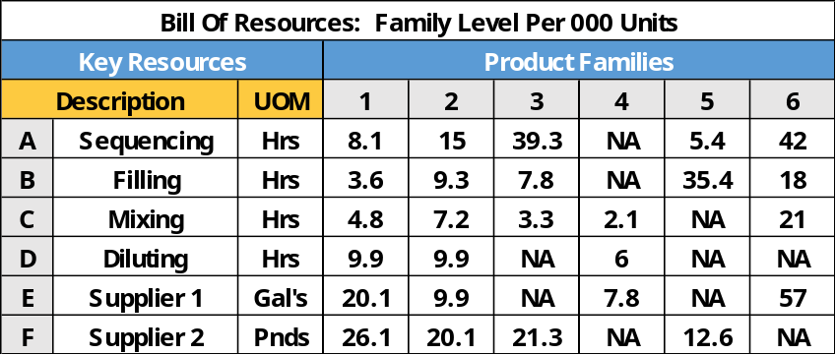
Bill Of Materials:
Linking Non-Aligned Resources To Product Families
Non-Aligned Resources
Bill Of Materials Example
Product
D
Product
E
Product
F
Production
Resource
1
Production
Resource
2
Production
Resource
3
Once non-aligned resources are known and understood, the pilot S&OP team must then construct a basic “bill of materials” that logically links a given product family to the non-aligned resources required to build products for that specific family.
Production
Resource
4
Production
Resource
5
Production
Resource
6
To make 1,000 units of family 3, 9.3 hours of “filling” is required
Family 4 does not require any filling in order to make products
Usually developed by evaluating raw materials routings through the production process for all products within a given family
Should always be cross-referenced with knowledge experts within engineering and production and procurement
Note: When building a basic bill of
resources, a single product is typically used to
represent The entire family
Last-Month Actual Results
Critical
Resource
Evaluation
Performance Metrics Review
Actual
Capacity
Used
Next-Month
Maintenance
Scheduling
On-Hand
Inventory
Analysis
Rough-Cut
Capacity
Analysis
Error Code
Evaluation
Second-Pass
Spreadsheet
“Capacity Plan”
Required Inventory Position

Slide 37
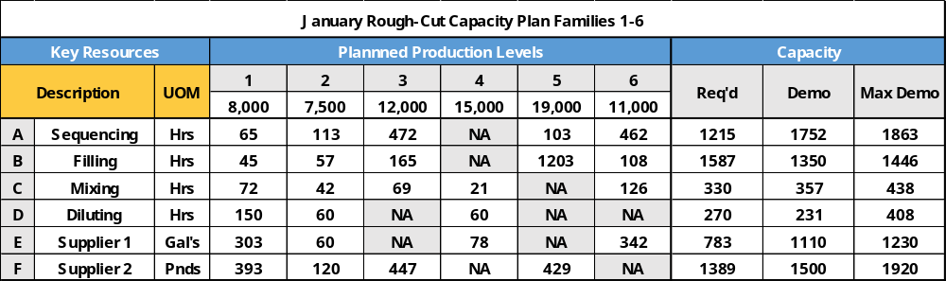
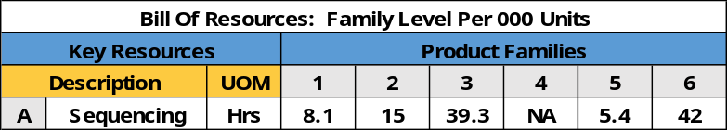
Rough-Cut Capacity Plan Example:
Do We Have Sufficient Resources?
By adding the operations plan into the bill of resources (what production plans to make for a give month), the S&OP pilot team can readily determine if sufficient resources or capacity exists to meet the production plan.
Do we fall below demonstrated capacity? If so, “go”
Do we rise above Max demonstrated capacity? If so, any viable solutions
Do we have excess capacity urgently needed elsewhere?
Focusing on sequencing: For family 1, 1,000 units requires 8.1 hours of mixing; 8.1 hours X 8 (for 8,000 units) requires 65 hours of sequencing
Planned production level for Product Family 5 are 19,000 units for the next-month cycle; 5.4 hours of sequencing X 19 (for 19,000 units) yields 103 hours of sequencing
Last-Month Actual Results
Critical
Resource
Evaluation
Performance Metrics Review
Actual
Capacity
Used
Next-Month
Maintenance
Scheduling
On-Hand
Inventory
Analysis
Rough-Cut
Capacity
Analysis
Error Code
Evaluation
Second-Pass
Spreadsheet
“Capacity Plan”
Required Inventory Position

Slide 38
Rough-Cut Capacity Plan Example:
Do We Have Sufficient Resources?
By adding the operations plan into the bill of resources (what production plans to make for a give month), the S&OP pilot team can readily determine if sufficient resources or capacity exists to meet the production plan.
Required Capacity | Sum of all resource demands (e.g. mix) for a given month
Demonstrated Capacity | Current capacity available for a resource; typically average actual output
Max Demp Capacity | Upper capacity limit by employing “extraordinary” means (e.g. overtime)
Maximum Demonstrated Capacity Typically Represents A Temporary
Condition, Not One That Is Foreseen As A Long-Term Sustainable Solution
Last-Month Actual Results
Performance Metrics Review
Critical
Resource
Evaluation
Actual
Capacity
Used
Next-Month
Maintenance
Scheduling
On-Hand
Inventory
Analysis
Rough-Cut
Capacity
Analysis
Error Code
Evaluation
Second-Pass
Spreadsheet
“Capacity Plan”
Required Inventory Position

Slide 39
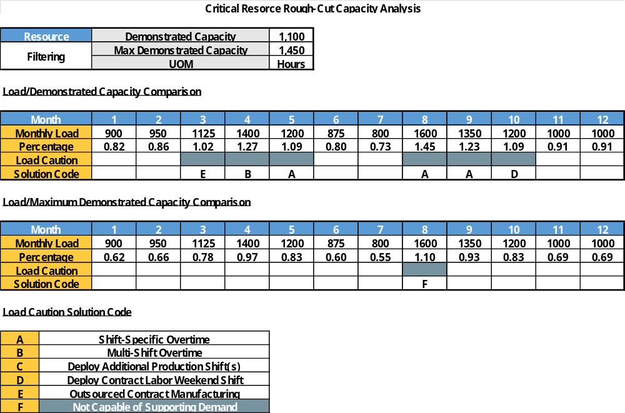
Critical Resource Capacity Report Example:
How Bottlenecked Are We?
Capacity reports not usually done for all resources; only the most critical “bottleneck” ones
Confirms key shortages to entire S&OP team rapidly – “Fact-based analysis”
Identifies potential solutions including overtime and extra shifts
Forces collaborative action planning; demand exceeds supply which must be corrected
Allows on-the-spot financial planning; confirm costs and benefits of potential solutions
Facilitates long-term capacity planning including new-resource additions and excess capacity
No wasted time on unnecessary analysis and discussions
Most S&OP processes develop rough-cut capacity reports for only the most critical resources; each critical resource is carefully evaluated each month to determine to what extent demand will outstrip available supply.
Rapid-Fire Trouble-Shooting: Most Common
Problems With Ready-Made Tailored Solutions
Last-Month Actual Results
Performance Metrics Review
Critical
Resource
Evaluation
Actual
Capacity
Used
Next-Month
Maintenance
Scheduling
On-Hand
Inventory
Analysis
Rough-Cut
Capacity
Analysis
Error Code
Evaluation
Second-Pass
Spreadsheet
“Capacity Plan”
Required Inventory Position

Slide 40
Critical Resource Evaluation Process:
Identify, Confirm, Solve
1
2
3
4
5
Tailored
Solutions
Before legitimate supply-demand matching can take place with the pilot S&OP team can take place, all product or family-specific critical resources must be evaluated, understood and matched to tailored solutions for S-D mismatches.
Product
D
Product
E
Product
F
Production
Resource
1
Production
Resource
3
Tailored
Solutions
Production
Resource
1
Production
Resource
2
Production
Resource
3
“Most Critical” Bottleneck Analysis
Production
Resource
4
Production
Resource
5
Production
Resource
6
Production
Resource
4
Tailored
Solutions
Last-Month Actual Results
Critical
Resource
Evaluation
Performance Metrics Review
Actual
Capacity
Used
Next-Month
Maintenance
Scheduling
On-Hand
Inventory
Analysis
Rough-Cut
Capacity
Analysis
Error Code
Evaluation
Second-Pass
Spreadsheet
“Capacity Plan”
Required Inventory Position

Slide 41
Critical Resource Evaluation Process:
Identify, Confirm, Solve
For given product or family, confirm non-aligned resources required for production
Evaluate non-aligned resources for critical or “bottleneck” resources based on product plan
Confirm most-critical resources requiring rough-cut capacity analysis for effective planning
Develop most-likely tailored solutions (e.g. overtime) for most commonly-anticipated problems
Construct rough-cut capacity reports for each critical resource based on forecasted demand
4
1
2
Tailored
Solutions
1
2
Product
D
Product
E
Product
F
Production
Resource
1
During the run-up to the first-pass S&OP monthly process, the pilot team will be in a good position to evaluate the selected product or family in order to complete the rough-cut capacity planning process where required.
Production
Resource
1
Production
Resource
2
Production
Resource
3
Production
Resource
3
Tailored
Solutions
“Most Critical” Bottleneck Analysis
3
Production
Resource
4
Production
Resource
5
Production
Resource
6
Production
Resource
4
5
Tailored
Solutions
4
3
5
S&OP Pilot Cannot Begin Until Collaborative Team Confirms
All Critical Supply Bottlenecks and Develops Most-Likely Solutions
Required For S&OP Pilot Success
Last-Month Actual Results
Critical
Resource
Evaluation
Performance Metrics Review
Actual
Capacity
Used
Next-Month
Maintenance
Scheduling
On-Hand
Inventory
Analysis
Rough-Cut
Capacity
Analysis
Error Code
Evaluation
Second-Pass
Spreadsheet
“Capacity Plan”
Required Inventory Position

Slide 42
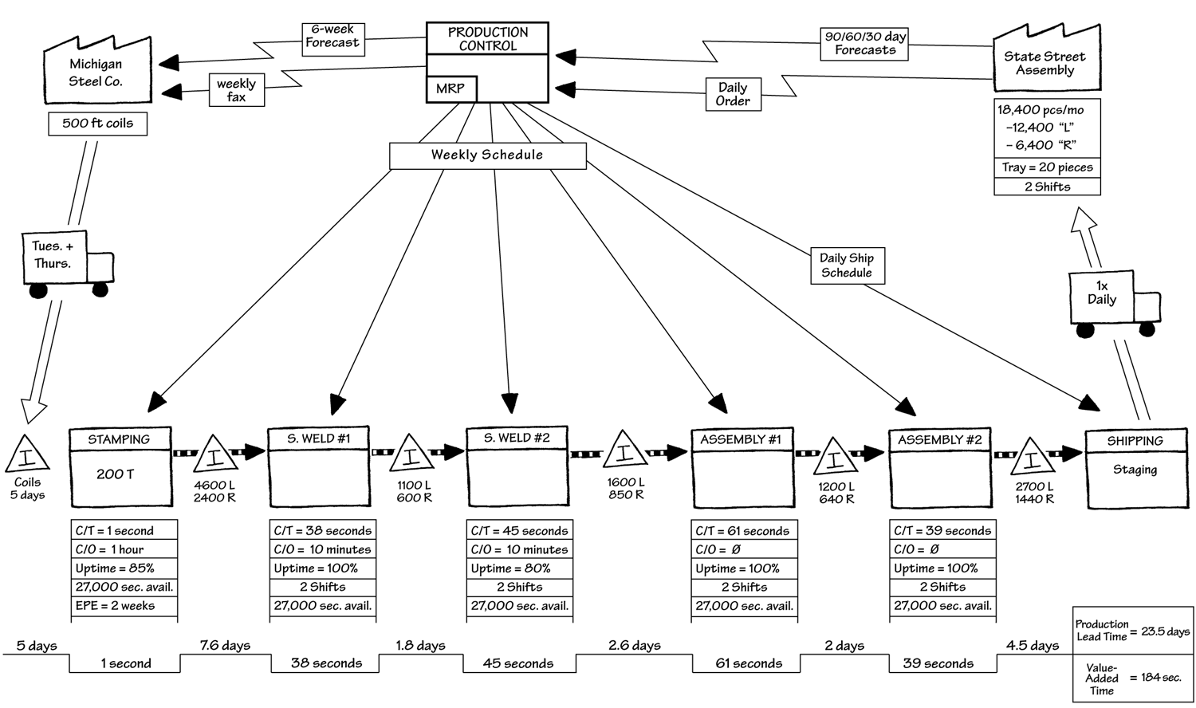
Critical Resource Evaluation:
Importance Of Value Stream Mapping
Process Analysis Priorities
Existing Product
Or Family Flow
Confirm Critical
Resources
An important lean tool in the critical resource analysis is the value stream map; detailed maps can alert the S&OP pilot team not only to existing production bottlenecks but hidden challenges that can be identified now and corrected before the S&OP launch.
Average Capacity &
Best Demonstrated
Consensus On
Rough-Cut Planning
Human Resource
Staffing Options
Tailored Solutions
Development
Catalog Existing
Breakpoints
Inputs For Long-
Range Planning
Critical Path
Move Forward
Value Stream Map Outputs
Last-Month Actual Results
Critical
Resource
Evaluation
Performance Metrics Review
Actual
Capacity
Used
Next-Month
Maintenance
Scheduling
On-Hand
Inventory
Analysis
Rough-Cut
Capacity
Analysis
Error Code
Evaluation
Second-Pass
Spreadsheet
“Capacity Plan”
Required Inventory Position

Slide 43
Supply Base Analysis:
Coverage, Excess or Potential Shortages?
Supplier Management Zones
For any product or product family, supply team members must document all supplier inputs
“Supplier management zones,” based on relationship lead times, indicate level of flexibility available
Based on the product or product family, understanding “where” supply planning is in the zone is critical
If there is a sudden up shift in demand, increasing raw material purchases is mandatory “if” possible based on relationships & leadtimes
For key decreases in demand, unloading potentially excessive materials purchases is desirable if the flexibility exists
Emphasizes the close, integrated relationships supply planners must have with their key suppliers
Firm Zone
$$$$
Flexible Zone
$$
No Commitment Zone
$ Or No Cost
Integral to the critical resource analysis is a thorough review of the supply base; supply team members must confirm raw materials (or 3d party services) availability or scale back incoming shipments if the demand plan warrants such action.
Supplier Lead Times & On-Hand Materials
Decision
Decision
Time
Little-No Flexibility To Change
“Where We Are” In
The Cycle
Some Flexibility To Change
Change At Will
Sudden Demand Shift: Can We
Quickly React With Financial Responsibility?
Last-Month Actual Results
Critical
Resource
Evaluation
“Know What We Can Change, When We Can Change It”
Performance Metrics Review
Actual
Capacity
Used
Next-Month
Maintenance
Scheduling
On-Hand
Inventory
Analysis
Rough-Cut
Capacity
Analysis
Error Code
Evaluation
Second-Pass
Spreadsheet
“Capacity Plan”
Required Inventory Position

Slide 44
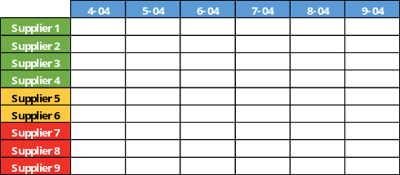
Supply Base Analysis:
Developing The Most Appropriate Supplier Plan
Demand Plan Receipt
On-Hand Raw Materials Inventory
Low – Expected -- Excess
Buying Plan (From Long-Range Forecast)
Firm Zone
Flexible Zone
No Commitment
Armed with lead time data, zone positioning and 3d-party alternatives, supply team members can then develop the most appropriate raw materials plans by adjusting purchase levels (where possible) and confirming insurmountable short-term hurdles.
Supplier 1
Supplier 2
Supplier 3
Supplier 4
Supplier 5
Quantified lead times (order-to-receipt)
OSCOT for each supplier
Quality and reject rate %’s
Material levels on-hand
Premium freight charges (if incurred)
Non-preferred supplier alternatives
On Plan
Raw
Materials
Stocks
Supplier
Expedite Or
Cancellation
3d-Party
Alternative?
Finalize
External
Supply Plan
Excess Demand
Diminished Demand
Next-Month
Supply Base
Purchases &
Alterations
Supplier-Specific Planning
Last-Month Actual Results
Critical
Resource
Evaluation
Performance Metrics Review
Actual
Capacity
Used
Next-Month
Maintenance
Scheduling
On-Hand
Inventory
Analysis
Rough-Cut
Capacity
Analysis
Error Code
Evaluation
Second-Pass
Spreadsheet
“Capacity Plan”
Required Inventory Position

Slide 45
Time Zone Planning:
What Is Fixed, What Is Flexible
Month | % Change Permissible
Current Month | Hold; schedule fixed for execution
Month One | +/- 15% change to plan permissible
Month Two | +/- 20% change to plan permissible
Month Three | +/- 30% change to plan permissible
Month Four | +/- 30% change to plan permissible
Month Five | +/- 35% change to plan permissible
Month Six | +/- 40% change to plan permissible
Third Quarter | Open; all changes permissible
In order to prevent downstream chaos, the pilot team must establish ground rules to govern extent to which the production plan can be modified
Time zones should exist in order to prevent unusual production spikes and valleys throughout the year
Proper time-zone establishment up-front drives further effort to create inherent flexibility; lean principles can allow more flexible time zone management
Just as proper time zone limits are required, the team should also implement sound override rules where needed
Bottom line – How economically can you operate close-in to the production schedule?
Just as important as error codes are effective time zones; constructing proper time zones allow the S&OP process to work without the effects of unnecessary production peaks or valleys.
Prevent Unnecessary Production Upheavals
Economics Should Drive Time Zone Creation;
What Can Be Done Based on Economic Viability?
Last-Month Actual Results
Critical
Resource
Evaluation
Performance Metrics Review
Actual
Capacity
Used
Next-Month
Maintenance
Scheduling
On-Hand
Inventory
Analysis
Rough-Cut
Capacity
Analysis
Error Code
Evaluation
Second-Pass
Spreadsheet
“Capacity Plan”
Required Inventory Position

Slide 46
Error Code Development:
Ready-Made Solutions For A Mismatch
Error Code | Description
A | Work available overtime on single shift
B | Overtime across multiple shifts/One day
C | Add single one-day additional shift
D | Transfer excess workload to Line XYZ
E | Transfer non-required family to Line XYZ
F | Transfer excess workload to contract mfg.
G | Demand cannot be profitably delivered
Forces pilot team to value stream map existing process to isolate potential solutions
Fact-based analysis to quantify what cannot be performed at a profitable level
Error code should be a logical cascade of events; relevant solutions for escalating supply-demand mismatch problems
Each error code should have a detailed contingency plan or written procedure behind it for accurate and timely implementation
Allows sales component of S&OP to work out potential customized solutions with customer when supply cannot profitably meet demand
May confirm long-term capacity shortages that must be eventually addressed
When developing error codes, the pilot S&OP team should concentrate on the “most likely” scenarios that will occur based on historical data, current-year trends and knowledge of available solutions.
S&OP Pilot Team Should Focus On The “Most Likely”
Scenarios In Order To Facilitate Rapid Decision Making
Gives Team Proactive Tools & Techniques
Last-Month Actual Results
Critical
Resource
Evaluation
Performance Metrics Review
Actual
Capacity
Used
Next-Month
Maintenance
Scheduling
On-Hand
Inventory
Analysis
Rough-Cut
Capacity
Analysis
Error Code
Evaluation
Second-Pass
Spreadsheet
“Capacity Plan”
Required Inventory Position

Slide 47
Business Plan Evaluation:
On-Target For Next-Month Revenue Cycle?
Similar to the demand planning cycle, supply team members must then evaluate the final supply plan (output) with the published revenue plan; is the S&OP on-track to deliver published revenue results for the next-month cycle?
Consensus Demand | Statistical Forecast | Business Plan | Stretch Goal | Supply Plan | Assumptions
420 | 350 | 400 | 475 | 420 | Shift 2 Overtime
Last-Month Actual Results
Critical
Resource
Evaluation
Performance Metrics Review
Actual
Capacity
Used
Next-Month
Maintenance
Scheduling
On-Hand
Inventory
Analysis
Rough-Cut
Capacity
Analysis
Error Code
Evaluation
Second-Pass
Spreadsheet
“Capacity Plan”
Required Inventory Position

Slide 48
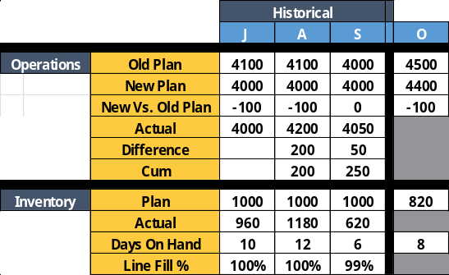
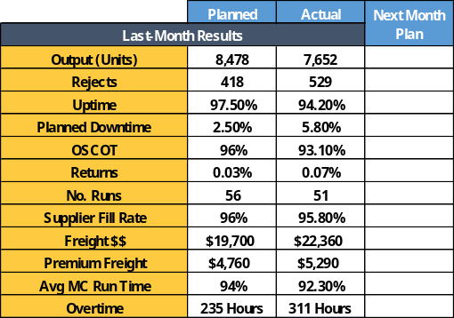
Supply Plan Summary Document:
The Plan, Assumptions & Performance
Clearly states the consensus next-month supply plan
Confirms last-month operations performance (and trending)
Highlights special circumstances including maintenance and reliability issues
Describes all key assumptions regarding internal capabilities and external impacts (e.g. supplier performance)
Clarifies opportunities including additional new supply sources
Combined, all areas should clearly demonstrate how the supply plan was established
Supply Plan Summary | Generic Product Line X | For Month of October 04 | Supply Plan: 4400 Units
Completing the cycle, supply planning team members will then complete the next-month supply plan summary outlining all key assumptions, constraints, and performance results in preparation for the supply-demand synchronization meeting.
Internal Assumptions
External Assumptions
Identified Risks
Supply Opportunities
Internal Special Circumstances
External Special Circumstances
Ready For Supply-Demand Meeting
Last-Month Actual Results
Critical
Resource
Evaluation
Performance Metrics Review
Actual
Capacity
Used
Next-Month
Maintenance
Scheduling
On-Hand
Inventory
Analysis
Rough-Cut
Capacity
Analysis
Error Code
Evaluation
Second-Pass
Spreadsheet
“Capacity Plan”
Required Inventory Position

Slide 49
Supply Plan Completion:
Preparing The Production Engine
Consensus Demand | Statistical Forecast | Business Plan | Stretch Goal | Supply Plan | Assumptions
420 | 350 | 400 | 475 | 420 | Shift 2 Overtime
With the supply plan complete and comparisons to the business plan made, the supply team can then begin the process of “green-lighting” the mechanical processes required to transition from planning to execution.
Develop And
Confirm
Net
Materials
Requirements
Make
Relevant
Modifications
To Rolling
12-Week
Master
Production
Schedule
Generate
Updated
Master
Production
Schedule
For Review
Conduct
Pre-MRP
Simulation
To Verify
Appropriate
Materials
Requirements
Develop And
Confirm
Net
Materials
Requirements
Update
MPS Based
On MRP
Simulation
Master Production Scheduling
Finalize Rolling
12-Week Schedule
Schedule Individual
SKU’s & Volumes
Finalize Supplier
Issues (If Present)
Release New
12-Week Schedule
Next-Month Build Scheduling
Last-Month Actual Results
Critical
Resource
Evaluation
Performance Metrics Review
Actual
Capacity
Used
Next-Month
Maintenance
Scheduling
On-Hand
Inventory
Analysis
Rough-Cut
Capacity
Analysis
Error Code
Evaluation
Second-Pass
Spreadsheet
“Capacity Plan”
Required Inventory Position

Slide 50
Supply Planning Summary:
Right Inputs, Optimized Build Plan
Optimal Production Plan
Monday, March 3
Last-Month Performance
Summary: With the right inputs combined with a consensus-driven demand plan, supply team members can assemble the most appropriate next-month build plan that optimizes utilization of all enterprise resources.
Maintenance Requirements
Shift 1
Shift 2
Shift 3
Line A
Item 001
Item 002
Staffing Plan
c/o
Consensus Demand
Line B
Item 002
Item 006
Inventory Position Needs
c/o
Idle
Line C
Item 001
Item 003
Rough-Cut Capacity Plan
c/o
Idle
Inputs
Optimized Plan
Build Schedule

Slide 51

Supply-Demand Consensus Meeting:
Forging Agreement For Next Month
Demand Plan
Supply Plan
Meeting Purpose
Overall state of the business
Performance metrics review
Specific product/family analysis
New product launches/effects
Production plan finalization
Procurement & sourcing needs
Document consensus decisions
Document parking lot items
Confirm executive meeting date
Confirm unresolved issues requiring executive review
Closing out the process, supply and demand team members have the responsibility to reach final consensus on the go-forward next-month S&OP plan that will be presented to senior management for sign-off.
Consensus Demand Plan
Consensus Supply Plan
Promotional Activities & Seasonality
Maintenance Requirements
New-Product Launches
Supply Constraints & Hurdles
Forecast Error Adjustments
Supply Base Requirements
Marketplace Assumptions
Rough-Cut Capacity Plan

Slide 52
Supply-Demand Consensus Meeting: Understanding All Impacts
Demand-Supply
Match
Team reaches mutual understand of all assumptions and market projections
Demand team fully confident in supply projections, build plans and resource allocations
Supply team has clear view on how demand team has incorporated forecast errors into plan
Common understanding on new product launches in the near term
If extraordinary supply measures undertaken (e.g. excessive overtime) demand team re-evaluates demand plan for potential reduction or “stretch” in demand plan
After documenting all assumptions, market needs and supply capabilities, the supply and demand teams are prepared to submit the next-month S&OP roadmap to senior management for their review and approval.
Demand Exceeds
Supply
Demand, even accounting for forecast error adjustments, exceeds available supply
Demand team fully understands bottlenecks and lack of reasonable & financially sound alternatives
Demand team critically evaluates demand plan looking for customer-friendly/acceptable alternatives
Financial impacts documented and evaluated; potential financial loss quantified
If mis-match cannot be resolved, document and present to executive team
Supply Exceeds
Demand
Can additional physical demand be moved forward to be included in the build plan?
Is surplus supply becoming a routine problem (where is the trend line going?
Confirm and document what additional demand can be met (if any) with additional supply
Team Now Prepared For Executive S&OP Sign-Off Meeting

Slide 53
Sales & Operations Planning
    Introduction To The Sales & Operations Planning Process
S&OP Logic Flow & Application In Different Operating Environments
S&OP Monthly Development Process & Execution Review
Demand Planning: Fundamentals of Consensus Demand Development
Supply Planning: Overview of Resource Management & Allocation
S&OP Spreadsheet Development, Responsibilities & Best Practices

Slide 54
Spreadsheet Building Blocks:
Complete Product Planning Snapshot
A
Product Information
Sales History
Sales Forecast
Operations History
Operations Build Plan
Inventory History
Inventory Position Plan
Demand Assumptions
Supply Concerns
A
B
Once the S&OP pilot team is prepared to assemble the basic S&OP spreadsheet mode, following a basic architecture will ensure development of a complete snapshot that will guide the team to the most accurate supply-demand match.
B
C
C
D
E
E
D
F
F
G
G
H
H
I
I

Slide 55
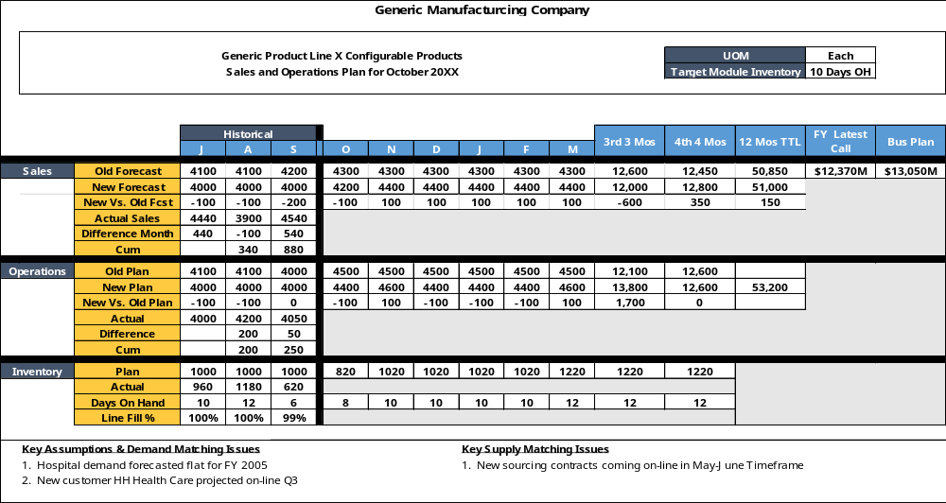
Sample Completed S&OP Spreadsheet:
MTS Environment
A
The completed S&OP spreadsheet will build a complete snapshot of the pilot family supply-demand position including “new vs. old” plan analysis and inventory deployment.
B
C
D
E
G
F
H
I

Slide 56
Sample Completed S&OP Spreadsheet:
One-Stop Planning Snapshot
Model Spreadsheet
A
Clear definition of the target product or family, unit-of-measure for the spreadsheet and required inventory levels to meet service requirements
Actual sales compared to the forecast; variances here should be evaluated for next-month accuracy improvement
Demonstrates the “long view” of the product; forecast extends for next six months and aggregates up for the next two full quarters
Actual production performance to plan; critical to evaluate for procurement linkages to suppliers and potential inventory/stock out impacts
The “long view” for the production cycle; first great defense for ensuring adequate supply lines to maintain production
B
When assembling the first S&OP spreadsheet draft, pilot team members
C
D
E
Logical, clear layout for team members to accurately
evaluate current position and future problems

Slide 57
Sample Completed S&OP Spreadsheet:
One-Stop Planning Snapshot
Model Spreadsheet
F
Simple inventory logic: Last-month ending inventory, less this-month new sales forecast, plus this-month ops plan gives ending inventory
  Project on-hand calculation is next-month new forecast/number of days in month (20)
Inventory position over next six months; gives strong indications of potential future service issues or excessive cash flow problems
Key assumptions for the demand equation; insights into market turbulence, key demand inputs or new-customer increases
Key assumptions for the supply equation; should include error codes where required, supply imbalances, critical assumptions, etc.
G
H
I
Logical, clear layout for team members to accurately
evaluate current position and future problems
Do We Know How To Match Supply & Demand?

Slide 58
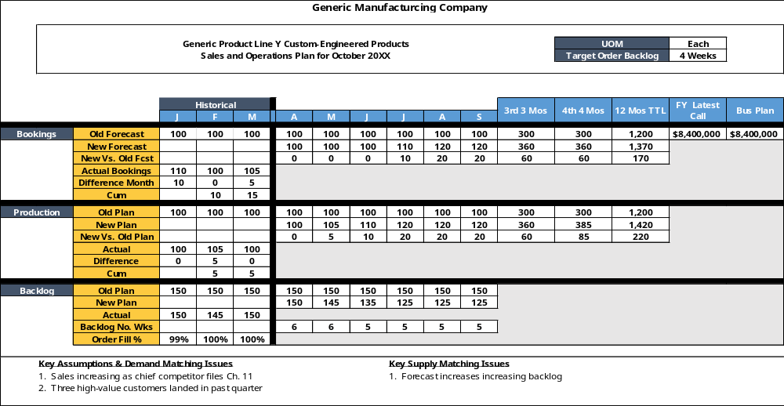
Sample Completed S&OP Spreadsheet:
MTO Environment
For pilots in a make-to-order (MTO) environment, team members must remember that S&OP processes are geared towards bookings and backlog management as MTO operations do not maintain inventory.

Slide 59
MTO Spreadsheet Creation:
Understanding Backlog Calculations
MTO Spreadsheet Example
Projected Backlog Calculation
Last-month ending backlog
[Plus] This-month new booking forecast
[Minus] This-month new operations plan
[Equals] This-month ending backlog
With MTO production operations, the S&OP pilot team should carefully assess the desired backlog levels prior to launch to ensure that customer service requirements are not sidelined during the implementation process.
Weeks In Backlog
New production plan
[Divided by] 4 (No. weeks per month)
[Equals] Weekly plan
[Divided into] Ending backlog
[Equals] Backlog in No. weeks
No inventory management – Only Backlog management
What is the desired backlog? No. Days? Weeks?

Slide 60
MTO Spreadsheet Creation:
Milestone Development Checklist
MTS Spreadsheet
Development Checklist
Confirm order fulfillment strategy
Develop customer service targets
Unit of measure (UOM) confirmation
Inventory targets to support customer service needs
Sales actuals and consensus forecast data
Production/operations actuals and forward build plan
Inventory/Backlog actuals and forward plan
Customer service level actual performance
Business plan financials comparison
Demand & supply match assumptions and critical issues
By following a simple, comprehensive checklist, pilot team members can be sure to include all vital components of the S&OP spreadsheet along with the data collection feeds required to populate the document every month.
MTO Spreadsheet

Slide 61
MTO Spreadsheet Creation:
Milestone Development Checklist
Operations
Key Assumptions
Last-Month Actuals
Build Plan Update
Capacity Planning
Error Code Ident
1st-Pass Spreadsheet
Process
Process
Process
Process
Process
Responsibility
Responsibility
Responsibility
Responsibility
Responsibility
Assembly
3rd-Pass Spreadsheet
New-Product Inputs
Key Assumptions
Process
During the pilot S&OP spreadsheet construction process, pilot team members would be well served to value stream map the data collection process and document key roles and responsibilities to ensure success.
Process
Responsibility
Last-Month Actuals
Fcast Error Analysis
Responsibility
Next-Month Fcst
2nd-Pass Spreadsheet
Process
Process
Process
Process
Responsibility
Responsibility
Marketing Promos
Responsibility
Responsibility
Process
Assembly
Sales
Responsibility
1
2
1
MTO S&OP Spreadsheet
2
MTS S&OP Spreadsheet

Slide 62
MTO Spreadsheet Creation:
Synchronizing Milestone Achievements
Last-Month Results
Day 0
Day 30
Data Assembly
Day 5
Demand Planning
Day 10
Supply Planning
Day 15
Pre-S&OP Meeting
Day 20
Exec S&OP Meeting
Day 22
During the value stream & process-mapping stage, pilot team members should carefully assess roles and responsibilities against the timing of required S&OP key milestones in order to synchronize activity completion.
Last-Month Actuals
Process
Task Description
Completion Process
Responsibility
Responsibility
Clear documentation of task itself and all sub-activities
Description of importance to S&OP process
Explicit description of timing & completion date
Defined “start” and “stop” boundaries
Process map of activities and sub-tasks
Confirm data collection sites and data accuracy verification processes
Clear samples of correct deliverables
Error-proofed to prevent submission of faulty data
Identified position to complete required tasks
Monthly time requirements
Performance expectations
Identified go-to content experts required to support completion efforts
Escalation path if required
Required For Every Process Step

Slide 63
MTO Spreadsheet Creation:
Building The S&OP Policy Manual
New Products
F-Cast Error Review
Error Code Analysis
All supporting documentation for a given activity should be “bundled” for effective review & instruction
Documentation should be dated for future routine review and alteration where required
Xxxx
Xxxx
Task Description
Responsibilities
Constructing key processes and responsibility matrices as the team formalizes the basic S&OP process will allow team to quickly assemble the final S&OP policy guidebook that will drive S&OP across the enterprise.
Process Completion Map

Slide 64
Adoption Of S&OP Disciplines:
Enhancement Of Key Business Drivers
Key Findings
Current %
Performance
Laggards (30% of study) have S&OP practices significantly behind cross-industry participants
Industry Norm (50% of study) have S&OP practices representing the average utilization of basic S&OP disciplines
Best-In-Class (20% of study) have institutionalized S&OP disciplines achieving top cross-industry performance
Recent comprehensive cross-industry studies have demonstrated the power of S&OP adoption; critical business drivers such as customer retention and gross margin are clear beneficiaries of S&OP disciplines.
Implications
S&OP practices are now seen as a key determinant in overall business performance
S&OP disciplines (even basic elements) drive improvements in all industries and all corporate environments
Supply disciplines provide equal improvement opportunities as demand planning disciplines

Slide 65
Adoption Of S&OP Disciplines:
Proven Performance Increases
% Improvement
Leading organizations are focused on profit growth, not just supply-demand balancing
S&OP decision makers cover the entire value chain, not just one or two independent silos
S&OP end-of-month results drive incremental, continuous improvement and not just data analysis
Successful S&OP teams are empowered to alter existing supply-demand plans when necessary
S&OP functions as a multi-purpose scenario-based planning tool that evaluates all possible outcomes
Utilization of single, “one plan” consensus-drive unconstrained demand forecast on the leading edge of successful S&OP implementations
“Response clarity” to differing supply-demand imbalances documented for decision making ease
Plan-Do-Check-Act process becomes second-nature
In fact, demonstrable improvements in fill rate and customer retention metrics demonstrate the untapped performance potential awaiting organizations preparing for S&OP implementation.
S&OP As A Competitive Weapon, Not A Process

Slide 66
Integrated S&OP Disciplines:
Profit By Design, Not By Accident
Integration Points Descriptions
1
Clear Profit Drive
S&OP process used to optimize product profitability as opposed to revenue growth or delivered cost – Target profit levels are established and supply-demand alternatives evaluated
2
Supply-Demand Sanity
S&OP teams derive the “best combination” of supply and demand to drive profitability; impacts of excess supply and unnecessary demand (demand that should not be served) understood
In any basic (and successful) S&OP process, fundamental building blocks are present that allow the S&OP team to maneuver the enterprise to clearly stated profit goals while promoting continuous improvement on a monthly basis.
3
Iterative Planning Cycle
All relevant contingencies are plotted and understood during the monthly S&OP cycle; senior management has full snapshot on profit impacts from supply constraints and unforeseen demand
4
Root Cause Confirmation
& Correction
Best-in-class companies use the basic S&OP metrics and detailed data bases to effect root-cause analysis in order to isolate planning problems and enact solutions to minimize any chance of a repeat
5
Closed-Loop
Decision Process
All critical elements of a basic S&OP process – Business transactions, decision support systems, analytics and performance dashboards – Are seamlessly linked to facilitate rapid response

Slide 67
Cross-Industry Successes:
Universal Appeal Of S&OP Capabilities
All industries benefited significantly from S& OP programs
Magnitude of improvement paralleled level of capital intensity & proximity to end consumer
Consistent results in selling organizations such as wholesalers and distributors
Sellers achieved significant benefits through S&OP processes driving stocking policies to annual and seasonal demand patterns
Service organizations utilizing S&OP found great benefit in utilizing demand planning as a driver for service technician staffing
All industries faced similar internal challenges including buy-in, sales support and adoption of continuous improvement disciplines
Contrary to popular beliefs that S&OP is only relevant in true manufacturing environments, S&OP has proven itself to be a highly effective change agent for improvement across a wide variety of industries.

Slide 68
Cross-Industry Opportunities:
Deployment Of “Complete” S&OP Disciplines
-- S&OP Demand Alignment --
-- Adoption Of Root Cause Analysis --
% Cross-Industry Adoption
% Cross-Industry Adoption
As a further sign of the power (and potential competitive advantage) that S&OP offers, cross-industry surveys indicate that less than 20% of organizations employ “complete” S&OP processes including customer-aligned demand and monthly root cause analysis.
Those organizations not employing customer-specific S&OP demand planning sub-optimize the enterprise
Lack of a systematic process for monthly error rate analysis prevents continuous improvement on all levels

Slide 69
S&OP Inhibitors:
Does [Client] Face These Challenges?
-- Key Cross-Industry Inhibitors To S&OP --
-- Inhibitor Descriptions & Root Causes --
Internal pushback such as sales not embracing consensus forecasts a key inhibitor
Many organizations found S&OP “competing” with other cost-cutting initiatives – Difficult to get traction
Lack of executive support (committing enterprise to S&OP) typically failed to mobilize key supply and demand resources
Some businesses did not embrace S&OP because there was not a compelling financial case to support the investment
At the outset, lack of basic forecasting capability or rough-cut capacity planning tool prevented any movement
Across all industries, internal pushback and lack of executive support were often cited as key reasons why basic S&OP disciplines were not adopted or institutionalized.
% Respondents With Top Difficulties
These Should Not Become Hurdles!

Slide 70
S&OP Implementation Success Factors: Right Message, Right Players
-- Key Cross-Industry S&OP Success Factors --
-- Value Of Trading Partner Participation --
Large number of firms found very positive results from collaboration with supply chain partners
End-use customers typically added significant value in establishing basic forecasting techniques & capabilities
Business case development typically overcome quickly as limited resource requirements eroded any resistance
Cross-functional internal teaming demonstrated value finance, sales, operations, and supply chain brings to the S&OP process
Overall program confirmed the value of a more tightly integrated supply chain
Organizations most successful in deploying S&OP found that clearly articulated executive sponsorship and cross-functional teaming were critical to the institutionalization of S&OP disciplines.
Right People, Right Signals, Right Partners
% Respondents Dealing With Implementation Approach

Slide 71
S&OP Implementation Journey: Transformation To Best-In-Class Planning
S&OP Discipline | Laggards | Average Integration | Best-In-Class
Basic Processes | Very fragmented and infrequent actions; few iterations each year | Monthly process including basic cost analysis with iterations to basic balancing | Multiple iterations per month to arrive at most appropriate profit-based build plan
Team Structure | No real integrated team with true S&OP decision authority | Team includes personnel with limited authority to commit resources to physical plan | S&OP is a core, institutionalized team fully authorized to adjust demand/build plans as required
Resource Utilization | Each business unit typically engaged in silo-based planning | Cross-SBU supply chain optimization plan covering manufacturing & customers | Cross-business unit participation evaluating total supply chain capacity planning
Decision Tools | No defined tools; loose documents, individualized processes & analysis | Formalized spreadsheet structure with key feeds from forecast & capacity planning | Pure profit optimization integrating consensus demand plans with supply constraints
Decision Making Processes | Limited to no alignment with sales and operations making individual optimization decisions | S&OP supply-demand match requires cross-functional approval (sales/manufacturing) | Decisions include sales, marketing, procurement, production & logistics
Supply Chain Collaboration | No cross-supply chain discussions, planning or workflow integration | Integration with at least 2-3 key customer or customer segments driving business | Near real-time business decision capability utilizing “comonized” tools/techniques
Completing the S&OP journey, most organizations find that after 12 months, the basic disciplines and collaboration points are established providing a robust S&OP process that successfully (every month, without fail) provides the most appropriate profit & build plan.
Beginning
Six Months
Twelve Months

Slide 72
S&OP Implementation Journey:
Best Practices For Complete Success
Implementation Best Practices
Profit-Driven:
Achieve Profits & Volume Matching
Migrate towards a basic S&OP strategy that includes a metric-driven, iterative (weekly) process focused on optimizing enterprise profits
Leverage supply chain partners and customers to expand improvements and demonstrate enterprise commitment to superior service levels
Implement and institutionalize the plan-do-check-act cycle so that results are openly critiqued, evaluated, and problems are isolated to improve the next S&OP iteration
S&OP should begin with a single, unconstrained consensus demand plan covering the customer base and financial business plan
Develop and implement a simple, spreadsheet-driven S&OP planning dashboard that is easily manipulated
Develop pre-made “what if” contingency scenarios that offer pre-packaged solutions for supply-demand mismatches
Supply Chain Collaboration:
All Decision Makers Involved
Summary: By following basic disciplines and S&OP frameworks, organizations migrating towards a “true” S&OP environment will allow profit optimization and supply chain collaboration to drive future improvements.
Continuous Improvement:
Systematic Problem Correction
Decision Empowerment:
S&OP Team Makes The Call
Supply + Demand = $$ Profits

Slide 73
    S&OP: Supply-Demand Match To Build The Right Production Plan
DDLP: Executing The Plan Via Shop Floor Precision & Accuracy

Slide 74
    Introduction: Matching The S&OP Build Plan To Production Capabilities
Creating The Pacemaker To Drive The Level Pull Process
Integrating Upstream Production Processes With The Pacemaker

Slide 75
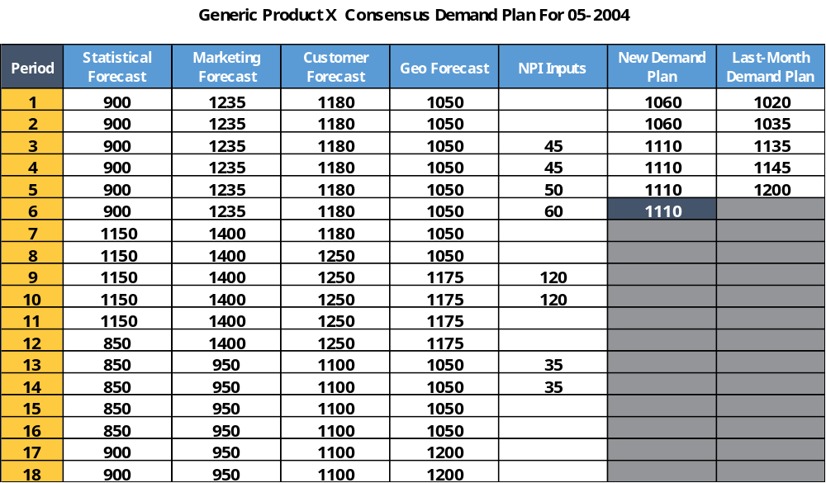
From S&OP To DDLP:
Translating Demand To Physical Production
Typically, forecasts are run through MRP well in advance to generate weekly run schedules
Erratic throughput times still means that a consensus demand plan can still result in shortages or surpluses
S&OP team members must not be lulled into thinking that a consensus demand plan guarantees high customer service
The key question to be asked is whether the current production system is reflexive (pull) or cognitive (push)
S&OP processes yield maximum benefits when linked to reflexive systems that allow each production point to signal readiness to build
Now that the operation has a solid consensus-based demand plan, the battleground shifts to the shop floor – Can the shop floor use the demand plan to “pull” products through production or must they be “pushed” to customers?
How Will The Shop Floor Be Scheduled To Execute?
Can We “Pull” Or Do We “Push?”

Slide 76
Basic Productions Models:
Cognitive Push And Reflexive Pull
1
Supplier
Build Step One
Build Step Two
Customer
Cognitive
Production
Process
The problem many production environments encounter is one of amplified variability; normal customer demand variability is translated to each production step creating scheduling and inventory management chaos.
70% Variation
Schedule To Schedule
40% Variation
Schedule To Schedule
20% Variation
Schedule To Schedule
2
Supplier
Build Step One
Build Step Two
Customer
Reflexive
Production
Process
Variation
Inventory Buffer
Minimal Internal Variation
Demand is either centrally planned and “pushed” through the shop floor
or “pulled” by each production process only at the time that stage of the process is prepared

Slide 77
Push Vs. Pull:
Deploying Right Solution For Customer Service
-- Cognitive Push Production Process --
-- Reflexive Pull Production Process --
Supplier
Build Step One
Build Step Two
Customer
Supplier
Build Step One
Build Step Two
Customer
Variation
Inventory Buffer
When engaged in a push production system, finite resources are generally mismanaged requiring the extensive use of buffer stocks as a necessary hedge against upstream variation.
70% Variation
Schedule To Schedule
40% Variation
Schedule To Schedule
20% Variation
Schedule To Schedule
Minimal Internal Variation
Production control (e.g. MRP) centralizes decision-making power and “pushes” raw materials through the floor
Demand variation typically creates intra-process variation amplifying problems
Inventories generally grow at each production point as a buffer to inherent instability and variation
Cumulative process variations results in highly unpredictable customer service levels
Production only advanced to next stage of production when next stage requires it
Orders are leveled and smoothed to protect shop floor production stages from high variability and chaos
Inventory buffers as a defense to demand variability mathematically calculated and located at their most beneficial location
Variation is therefore “absorbed” within the process to guarantee reliable customer service
Push To Mismanage Finite Resources
Pull To Improve Customer Service

Slide 78
Beginning The DDLP Journey Through
Single Product Family Focus
Stage Two: Future Focus
Stage One
Supplier
Build Step One
Build Step Two
Customer
During the pre-planning for a basic DDLP process, team members should begin their improvements as close to the end customer as possible while working with a single product family – “Start small and make a big impact.”
Start close to the customer so customers can see the immediate impacts
Isolate pilot to a single family (same S&OP family) to learn how disciplines and practices are to be applied
1
2
3
1
2
3
Build-Inventory Split:
What To Hold In Inventory, And
What To Make From Orders
Buffer Stock Confirmation:
What To Hold In Inventory As
A Buffer To Known Variation
Finished Goods Control
Efficient Inventory Management
To Simplify & Streamline
Three Key Steps To Start The DDLP Journey

Slide 79
Build Decision:
What Is from Inventory Or Built From An Order?
Classification | SKU No. | TTL SKU’s | % Demand
A | 335 | 5 | 60%
 | 336
 | 337
 | 338
 | 339
B | 1740 | 5 | 20%
 | 1741
 | 1742
 | 1743
 | 1744
C | 890-894 (5) | 15 | 20%
 | 1153-1157 (5)
 | 1802-1806 (5)
First critical step is to conduct a Lean ABC analysis to confirm order patterns
A’s are high runners with frequent orders (daily or several times per week)
B’s are medium runners with semi-frequent orders (several per week or month)
C’s are low runners with very infrequent order patterns including 2-3 times per month, odd configurations, etc.
Most common mistake is that production builds all three classes with the same centralized process with large finished goods inventories as buffers
With the ABC analysis, production team members can then determine what will be held in inventory and what will be build only upon order receipt
As the first critical step, team members must determine (for the pilot product family) what finished goods will be carried in inventory for release to customers, and what items will only be made upon receipt of a physical order.
Where Should Our Focus Be?
Serve From Buffer Or Build After Order

